Slide 1
Multithreading/Multitasking
INFO 6350

Slide 2
Process vs Thread
Two basic units of execution: processes and threads.
Concurrent programming is mostly concerned with threads.
A computer system normally has many active processes and threads. Single execution core, sharing processing among processes and threads through time slicing.

Slide 3
Thread
A lightweight way to implement multiple paths of execution inside of an application.
A non-concurrent application: only one thread of execution - starts and ends with the application’s main routine and branches one-by-one to different methods or functions to implement the application’s overall behavior.
A concurrent application: starts with one thread and adds more as needed to create additional execution paths.
Each new path has its own custom start routine that runs independently of the code in the application’s main routine.

Slide 4
Why Threads
Two very important potential advantages:
Multiple threads can improve an application’s perceived responsiveness.
Multiple threads can improve an application’s real-time performance on multicore systems.

Slide 5
Terminology
The term thread is used to refer to a separate path of execution for code.
The term process is used to refer to a running executable, which can encompass multiple threads.
The term task is used to refer to the abstract concept of work that needs to be performed.

Slide 6
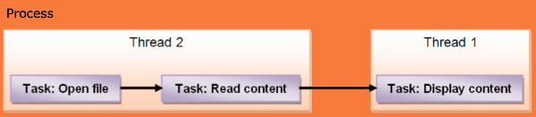
Task/Thread/Process
Copyright raywenderlich.com

Slide 7
Threading Support
Cocoa threads
  implements threads using the Thread
  provides methods on NSObject for spawning new threads and executing code on already-running threads.
POSIX threads
  a C-based interface for creating threads
  int threadError = pthread_create(&posixThreadID, &attr, &PosixThreadMainRoutine, NULL);

Slide 8
Run Loops
Run loops are part of the fundamental infrastructure associated with threads. ( class RunLoop)
A run loop is an event processing loop that you use to schedule work and coordinate the receipt of incoming events.
The purpose of a run loop is to keep the thread busy when there is work to do and put the thread to sleep when there is none.
Your application cannot either create or explicitly manage RunLoop objects.
Each Thread object—including the application’s main thread—has an RunLoop object automatically created for it as needed.
The current thread’s run loop, is accessed using the class method current.

Slide 9
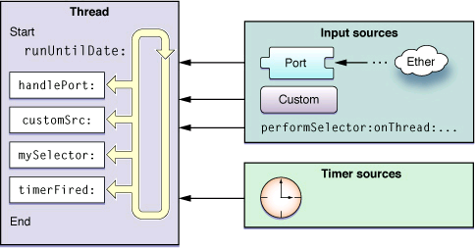
Run Loops
( RunLoop )

Slide 10
The only time you need to run a run loop explicitly is when you create secondary threads for your application.
The run loop for your application’s main thread is a crucial piece of infrastructure. It is set and started automatically.
User where you want more interactivity with the thread such as doing any of the following:
    Use ports or custom input sources to communicate with other threads.
    Use timers on the thread.
    Use any of the performSelector… methods in a Cocoa application.
    Keep the thread around to perform periodic tasks.

Slide 11
Thread Management
Thread creation costs:
  1 KB : Kernel data structures - memory is used to store the thread data structures and attributes
  Stack space: 512 KB (secondary threads)
        1 MB (iOS main thread)
  Creation time: Approximately 90 microseconds – on iMac with a 2 GHz Core Duo processor and 1 GB of RAM

Slide 12
Creating a Thread
There are 3 ways to create a thread using the Thread class:
Use the func detachNewThreadSelector(_ selector: Selector, toTarget target: Any, with argument: Any?) class method to spawn the new thread.
Create a new Thread object and call its start method.
Subclass Thread and override its main method. Use the overridden version of this method to implement the thread’s main entry point.

Slide 13
Thread.detachNewThreadSelector:
@selector(myThreadMainMethod:), toTarget:self,
with:nil)
//----
let myThread = Thread( target:self, selector:@selector(myThreadMainMethod:), object:nil)
myThread.start(); // start the thread

Slide 14
Performing selectors on other threads
func performSelector(onMainThread aSelector: Selector, with arg: Any?, waitUntilDone wait: Bool)
func performSelector(onMainThread aSelector: Selector, with arg: Any?, waitUntilDone wait: Bool, modes array: [String]?):
  On Main Thread
func perform(_ aSelector: Selector, on thr: Thread, with arg: Any?, waitUntilDone wait: Bool)
func perform(_ aSelector: Selector, on thr: Thread, with arg: Any?, waitUntilDone wait: Bool, modes array: [String]?)
  On a specific thread
func performSelector(inBackground aSelector: Selector, with arg: Any?)
  On the current thread
func cancelPerformSelectors(withTarget target: Any):
func cancelPerform(_ aSelector: Selector, target: Any, argument arg: Any?):
  cancel a message sent to the current thread (RunLoop)

Slide 15
Using NSObject extension to Spawn a Thread
All objects have the ability to spawn a new thread and use it to execute one of their methods.
func performSelector(inBackground aSelector: Selector, with arg: Any?) method creates a new detached thread and uses the specified method as the entry point for the new thread.
Ex:
self.performSelector(inBackground:#selector(doSomething), with:nil)

Slide 16
Terminating a Thread
The recommended way to exit a thread is to let it exit its entry point routine normally.
Killing a thread prevents that thread from cleaning up after itself. Memory allocated by the thread could potentially be leaked and any other resources currently in use by the thread might not be cleaned up properly, creating potential problems later.

Slide 17
func longRunningProcess()
{
while (self.running == true) {
// app logic goes here
}
}

Slide 18
Prioritizing Thread Work
var qualityOfService: QualityOfService
    Used to indicate the nature and importance of work to the system.
    Work with higher quality of service classes receive more resources than work with lower quality of service classes whenever there is resource contention
    userInteractive (33), userInitiated (25), utility, background, `default` (-1)
var threadPriority: Double ( 0.0 – 1.0)
    the priority is determined by the kernel
    in this range priorities are mapped to the operating system's priority values. Typical = 0.5

Slide 19
Synchronization
Use memory barriers or locks.
Best is to design to avoid the need for synchronization
class NSLock
  An object that coordinates the operation of multiple threads of execution within the same application.

Slide 20
Atomic Operations
(Depricated)
Atomic operations let you perform simple mathematical and logical operations on 32-bit or 64-bit values.
These operations rely on special hardware instructions (and an optional memory barrier) to ensure that the given operation completes before the affected memory is accessed again.
Ex:
OSAtomicAdd32
OSAtomicAdd32Barrier

Slide 21
Using the @synchronized Directive
( for objective-c only)
- (void)myMethod:(id)anObj { @synchronized(anObj) {
  // Everything between the braces is protected by //the @synchronized directive.
  }
  }
  Note: no direct equivalent in Swift. Can use NSLock, GCD barriers,
  objc_sync_enter(lockObj)/ defer { objc_sync_exit(lockObj) }

Slide 22
Other Locks
NSRecursiveLock class defines a lock that can be acquired multiple times by the same thread without causing the thread to deadlock
An NSConditionLock object defines a mutex lock that can be locked and unlocked with specific values.
The NSDistributedLock class can be used by multiple applications on multiple hosts to restrict access to some shared resource, such as a file.
The NSCondition class provides the same semantics as POSIX conditions, but wraps both the required lock and condition data structures in a single object.

Slide 23
Concurrency APIs in iOS
GCD (Grand Central Dispatch):
  Manages task queues for threading.
NSOperation & NSOperationQueue:
  Object-oriented approach to concurrency.
Swift Concurrency (async/await):
  Modern approach using structured concurrency.
Main Thread Rule:
  All UI updates must happen on the Main Thread.

Slide 24
GCD ( Grand Central Dispatch)
    a lightweight way to represent units of work that are going to be executed concurrently.
    You don’t schedule these units of work; the system takes care of scheduling for you.
    Adding dependency among blocks can be a headache.
    Canceling or suspending a block creates extra work for you as a developer
NSOperation /Operation
    adds a little extra overhead compared to GCD,
    Can add dependency among various operations and re-use, cancel or suspend them.
    KVO-Compliant Properties ( isCancelled, isExecuting …)
    Build on top of GCD
    Execute operations by adding them to an operation queue (an instance of the OperationQueue class). Or by calling its start() method
    Subclass operation by overriding its method called main()
    Use when you need fine-grained control over task execution, especially when operations depend on each other, or when you want to easily pause, resume, or cancel operations.

Slide 25
GCD Basics:
  GCD provides global queues for background and main tasks.
  Use DispatchQueue to manage tasks.
NSOperation and NSOperationQueue Overview:
  NSOperation offers more control compared to GCD.
  Allows dependency management and prioritization.

Slide 26
Operation Classes
Operation:
  The base class for defining custom operation objects.
NSInvocationOperation:
  Use as-is
  concrete subclass of NSOperation that manages the execution of a single encapsulated task specified as an invocation.
  Use to initiate an operation that consists of invoking a selector on a specified object.
BlockOperation:
  Use as-is to execute one or more block objects concurrently.
  only when all of the associated blocks have finished executing is the operation itself considered finished.

Slide 27
Using NSInvocationOperation
(Objective-c only)
The main method which you want the action to happen on, e.g. a button click method:
- (void)ButtonClickMethod: (id) sender
The method you want to run in the background:
- (void)BackgroundMethod: (id)sender
The method you want to run when the background method is finished:
- (void) DoneMethod

Slide 28
Create the following inside ButtonClickMethod () - setup an action/task
NSInvocationOperation *operation = [[NSInvocationOperation alloc] initWithTarget:self
selector:@selector(BackgroundMethod:) object:self];
add it into the queue of operations which then requests the operation get executed:
  NSOperationQueue opQueue = [[NSOperationQueue alloc] init];
[opQueue addOperation: operation];
When the BackgroundMethod code finishes, you need to include a call to the DoneMethod to clear up any unused objects, restore, and change the state of the view as you see fit.
    [(myViewController *)sender DoneMethod ];

Slide 29
Blocks and Concurrency
Blocks are portable and anonymous objects encapsulating a unit of work that can be performed asynchronously at a later time.
Are a central feature of both Grand Central Dispatch (GCD) and the OperationQueue(technologies for concurrent processing)
An OperationQueue is an object that schedules tasks to be performed concurrently or in an order defined by dependency relationships.
The tasks are represented by Operation objects, which frequently use blocks to implement their tasks.

Slide 30
class var current: OperationQueue?
  Returns the operation queue that launched the current operation
  Called from within a running operation object
class var main: OperationQueue
  Returns the operation queue associated with the main thread
  The returned queue executes one operation at a time on the app’s main thread
func addOperation(_ op: Operation)
  Adds the specified operation object to the receiver
  Once added, the specified operation remains in the queue until it finishes executing

Slide 31
BlockOperation
import Foundation
let operation = BlockOperation {
print("Executing block operation")
}
// Start the operation manually
operation.start()
let operation = BlockOperation()
operation.addExecutionBlock {
print("Task 1 started")
}
operation.addExecutionBlock {
print("Task 2 started")
}
operation.addExecutionBlock {
print("Task 3 started")
}
// Execute the operation
operation.start()
You can add multiple blocks to a single BlockOperation. All blocks will run concurrently
You can add dependencies
  operation2.addDependency(operation1)
You can add BlockOperation instances to an OperationQueue to manage execution:
    operationQueue.addOperation(operation)

Slide 32
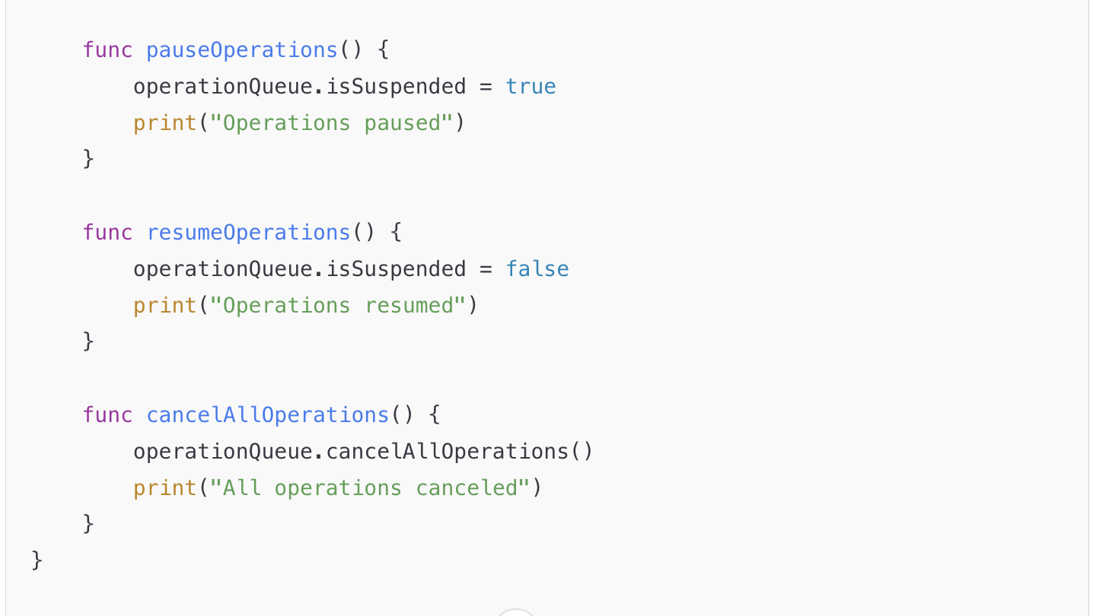
OperationQueue management

Slide 33
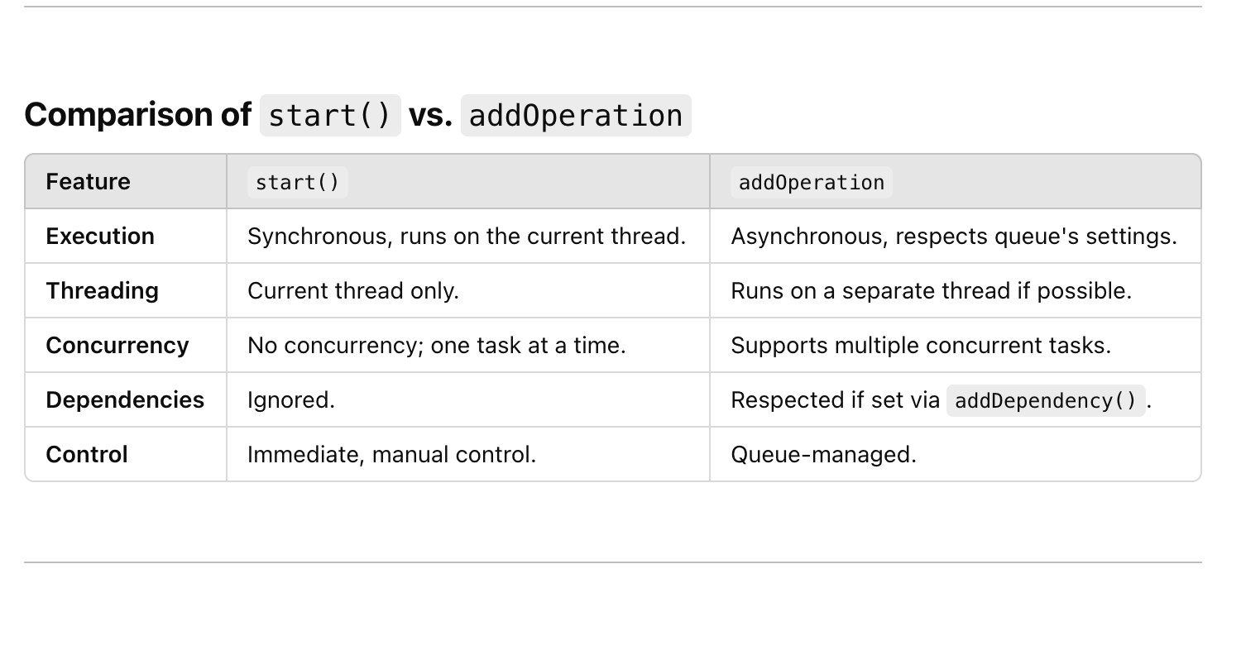
Use start() or addOperation()

Slide 34
lazy var downloadQueue:OperationQueue = {
var queue = OperationQueue()
queue.name = "Download queue"
queue.maxConcurrentOperationCount = 1
return queue
}()

Slide 35
Dispatch Queues
Two types of queues
  Concurrent:
    blocks run on separate threads
  FIFO:
    blocks run one after the other, each one waiting for the previous one to finish.
Regardless of the type of queue, blocks are started in the order they are placed onto a particular dispatch queue.
Concurrent queues will create as many threads as needed to run the tasks. The GCD (Grand Central Dispatch) framework decides how many threads would make sense.

Slide 36
GCD Dispatch Queue Types
Main queue: Runs on the main thread and is a serial queue.
Global queues: Concurrent queues shared by the whole system. Four such queues exist, each with different priorities: high, default, low and background. The background priority queue has the lowest priority and is throttled in any I/O activity to minimize negative system impact.
Custom queues: Queues you create that can be serial or concurrent. Requests in these queues end up in one of the global queues.

Slide 37
Accessing a Queue
DispatchQueue.global().
  Returns one of the three built-in concurrent queue (low, medium, high) priority
  can specify the Quality of Service class
DispatchQueue.main
  Returns the dispatch queue on the main thread
  FIFO queue, and tasks are run at ‘event time’ (i.e. inside the run loop).
DispatchQueue(label: ”myQueue", qos: .utility)
  create own FIFO queue

Slide 38
Running a task
async().
  start an asynchronous task
  let anotherQueue = DispatchQueue(label: ”myQueue", qos: .utility)
  anotherQueue.async {
  for i in 0..<10 {
  print(i)
  }
  }
  All variables in scope at the time the block was created are valid for the block’s execution.

Slide 39
//Concurrent queue
let queue = DispatchQueue(label: ”myQueue", qos: .utility, attributes: .concurrent)
//Delay execution
    delayQueue.asyncAfter(deadline: .now() + additionalTime) {
    print(Date())
    }

Slide 40
Use async when:
  to perform a network-based or CPU intensive task in the background and not block the current thread.
How and when to use the various queues with async:
Main Queue:
  a common choice to update the UI after completing work in a task on a concurrent queue.
  code one closure inside another. Targeting the main queue and calling async guarantees that this new task will execute sometime after the current method finishes.
Global Queue:
  common choice to perform non-UI work in the background.
Custom Serial Queue:
  A good choice to perform background work serially and track it. This eliminates resource contention since you know only one task at a time is executing.
  if you need the data from a method, you must inline another closure to retrieve it or consider using sync.

Slide 41
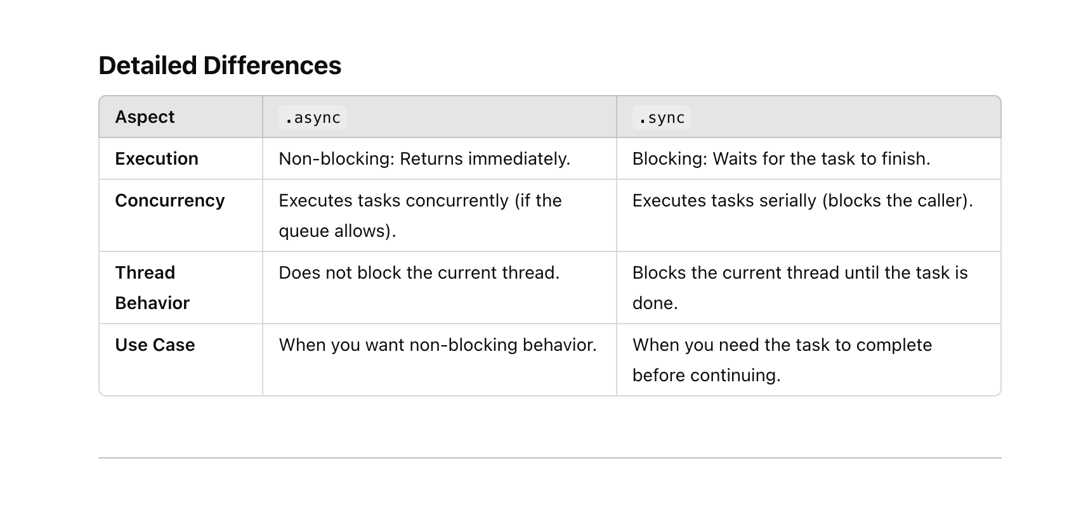
async/sync

Slide 42
Dispatch Queue(Objective-C)
Create a queue: (own queue = FIFO)
  init(__label label: UnsafePointer<Int8>?, attr: __OS_dispatch_queue_attr?)
  DISPATCH_QUEUE_SERIAL , DISPATCH_QUEUE_CONCURRENT
  let queue = DispatchQueue(label: ”myqueue")
  let queue2 = DispatchQueue(label: ”myQueue2", qos: DispatchQoS.userInitiated)
Add tasks to a queue:
  func async(execute: DispatchWorkItem)
  queue.sync {//clause }
Wait for a queue to empty
dispatch_sync(myQueue, ^{});
  Use this method if there is one queue only and don’t mind blocking the thread until the task is done, and tasks are not too long
push an async block to notify when the block runs.
  dispatch_async(_queue, ^{ [self allTasksDone]; }

Slide 43
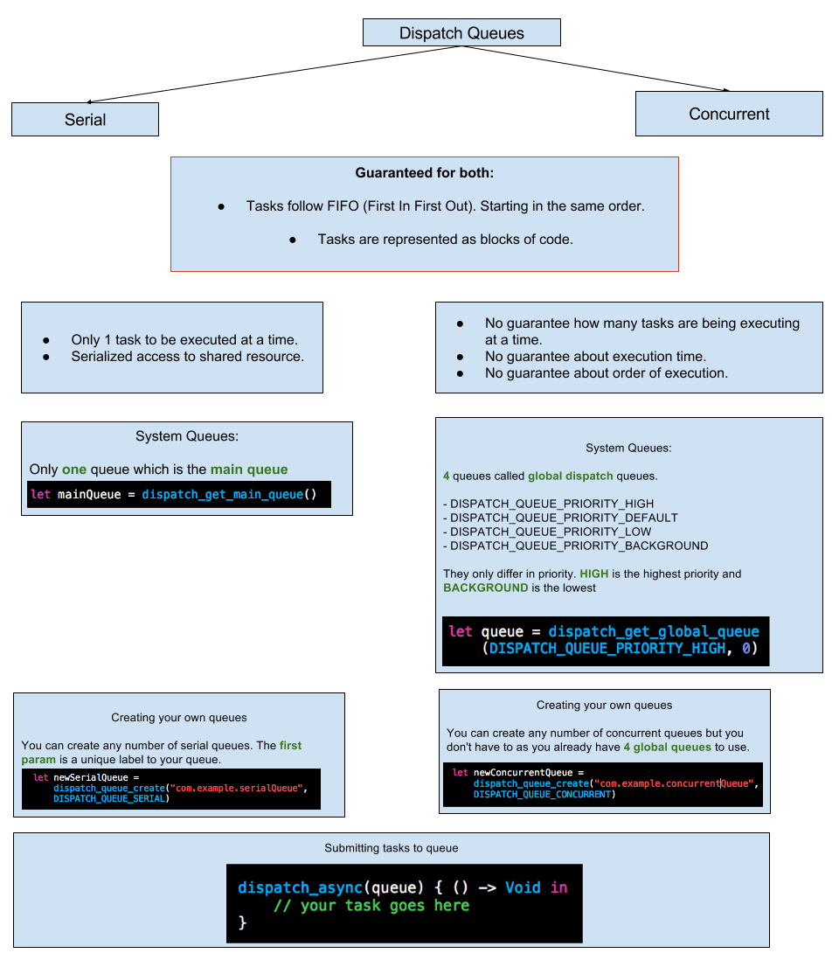
copyright: appcoda.com

Slide 44
DispatchWorkItem
block of code that can be dispatched on any queue:
  let workItem = DispatchWorkItem {
  // Do something
  }
workItem.perform()
    dispatch on main thread
queue.async(execute: workItem)
    Dispatch on a specific queue
workItem.notify(queue: DispatchQueue.main) {}
    Can notify the main queue, when work item is dispatched (finish execution)

Slide 45
Key Features of DispatchWorkItem
Customizable Execution:
  You can define what the task will do when executed.
Cancellable:
  Allows you to cancel the task before or during its execution.
Notification on Completion:
  You can specify code to run after the task is completed using a completion handler.
Using Completion Handlers
  You can add code to execute after the task is completed:

Slide 46
//create a DispatchWorkItem
let workItem = DispatchWorkItem {
print("Task is running...")
}
// Completion handler
workItem.notify(queue: DispatchQueue.main) {
print("Task completed!")
}
// Execute the work item
DispatchQueue.global().async(execute: workItem)
Limitations:
A DispatchWorkItem only works for tasks handled by GCD queues.
For more complex concurrency patterns, consider Swift Concurrency (async/await) or NSOperation.

Slide 47
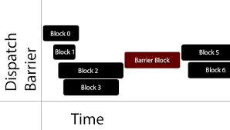
Dispatch Barriers
A dispatch barrier is a group of functions executing in a serial queue. It helps synchronise executing one or more tasks in a dispatch queue.
Use barriers when you need a queue to be delayed.
A dispatch barrier allows the creation of a synchronization point within a concurrent dispatch queue
Dispatch barriers only work on custom concurrent queues created using DispatchQueue(label:attributes:).They do not work on global concurrent queues
copyright: medium,.com

Slide 48
Synchronization Point:
  Tasks submitted before the barrier execute first.
  The barrier task executes next, blocking the queue.
  Tasks submitted after the barrier wait until the barrier task completes.
Submitting a Barrier Block
  Use async(flags:) with .barrier to submit a barrier block:
      concurrentQueue.async(flags: .barrier) {
      // Code in this block is executed exclusively
      print("Barrier: Writing data...")
      }

Slide 49
Dispatch Groups
Allow for the grouping of multiple tasks together and allow to wait for those tasks to complete before continuing with other code.
Create a group
  DispatchGroup.init()
Add to a group
  func enter()
  Explicitly indicates that a block has entered the group
To wait on the group
  func wait() , wait(timeout: DispatchTime), wait(wallTimeout: DispatchWallTime)
Notify when all queues are empty
  func notify(queue: DispatchQueue, work: DispatchWorkItem)
    Schedules a work item to be submitted to a queue when a group of previously submitted block objects have completed.

Slide 50
OperationQueues/Dispatch Queues
Dispatch queues are an easy way to perform tasks asynchronously and concurrently in your application.
Unlike GCD, Operation Queues don’t conform to the First-In-First-Out order. Here are how operation queues are different from dispatch queues:
  In operation queues, you can set priority for your operations and also you can add dependencies to the operations which means you can define that some operation execute only after the completion of other operations.
  Operation queues operate concurrently and if you want to use them as serial queue you should handle it with adding dependencies.

Slide 51
Swift Concurrency: async/await
Introduced in Swift 5.5, async/await simplifies threading.
Allows writing asynchronous code that looks synchronous.
func fetchData() async {
  do {
  let data = try await fetchNetworkData()
  DispatchQueue.main.async {
  label.text = "Data loaded"
  }
  } catch {
  print("Error: \(error)")
  }
  }

Slide 52
Threading Rules in Swift and UIKit
Do’s:
  Use the Main Thread for UI updates.
  Offload heavy tasks to background threads.
Don’ts:
  Avoid blocking the main thread with long-running tasks.
  Never update the UI from a background thread.

Slide 53
Common Threading Patterns
Loading images asynchronously:
DispatchQueue.global(qos: .userInitiated).async {
if let image = loadImage() {
DispatchQueue.main.async {
imageView.image = image
}
}
}
Using async/await for structured concurrency:
func loadImage() async -> UIImage? {
let imageData = try? await URLSession.shared.data(from: imageUrl)
return imageData.flatMap { UIImage(data: $0) }
}

Slide 54
Key Concepts of Concurrency in SwiftUI
async/await:
  Allows asynchronous operations to look like synchronous code, making it easier to read and maintain.
Tasks:
  A Task is a unit of asynchronous work.
  SwiftUI integrates tasks directly into the lifecycle of its views using task and onAppear.
Actors:
  Provide a thread-safe way to manage state in a concurrent environment.
Task Priorities:
  Helps manage the importance of tasks, e.g., .userInitiated, .background.

Slide 55
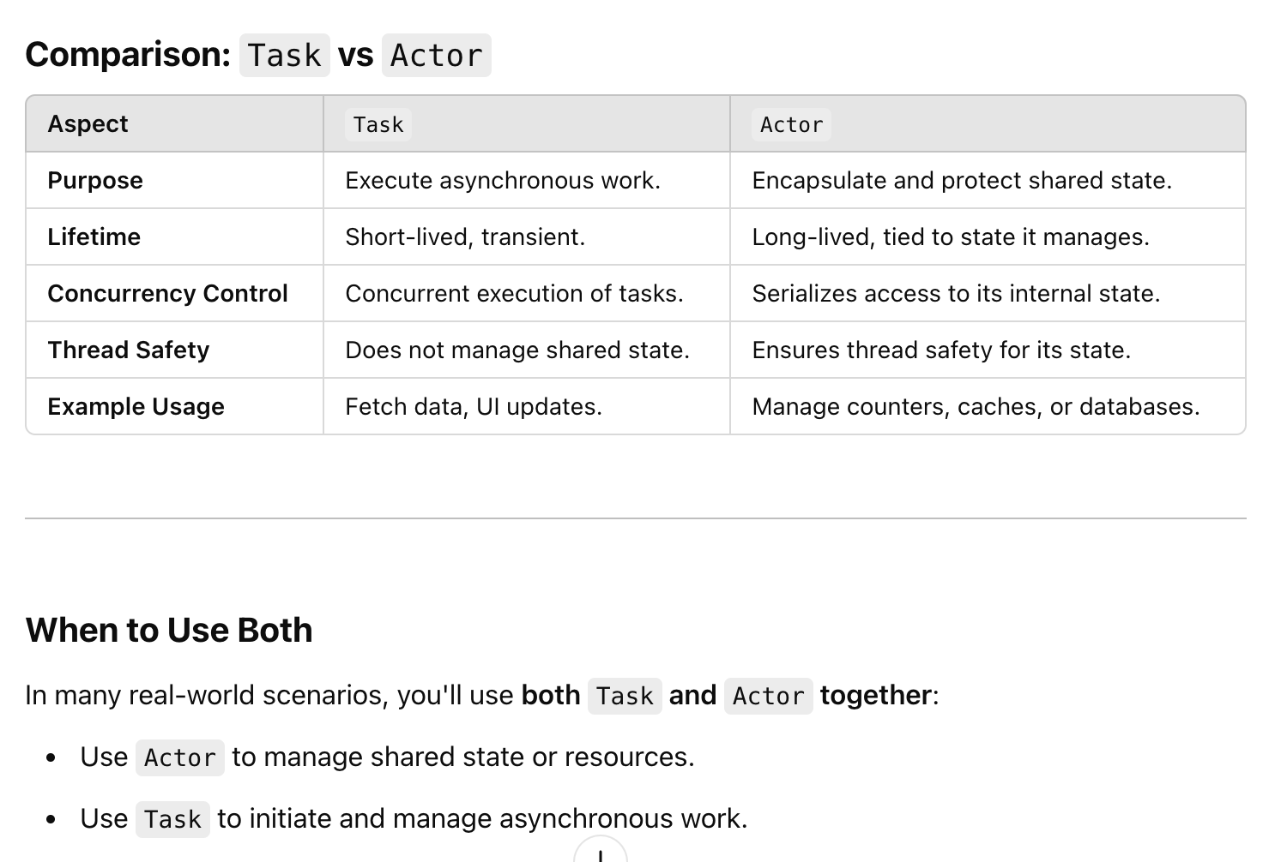
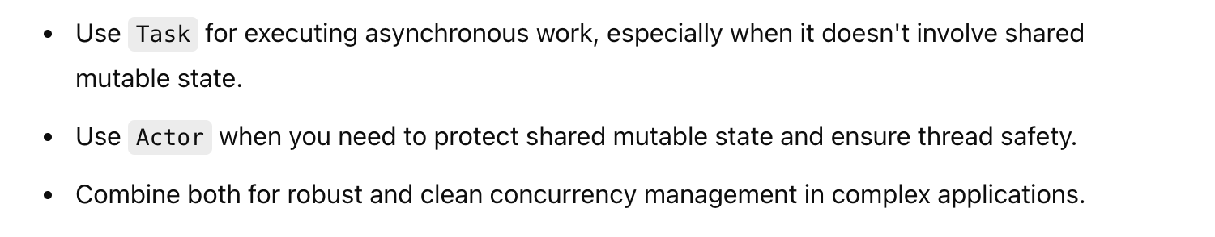

Slide 56
Using @MainActor for UI Updates
UI updates must occur on the main thread. Swift provides @MainActor to enforce this
    @MainActor
    func updateUI(with message: String) {
    self.data = message
    }

Slide 57
Error Handling with async/await
Swift concurrency supports try, catch, and do blocks for handling errors:
      func fetchData() async {
      do {
      let data = try await fetchFromServer()
      await MainActor.run {
      self.data = data
      }
      } catch {
      await MainActor.run {
      self.data = "Failed to fetch data"
      }
      }
      }

Slide 58
Using TaskGroup for Concurrent Subtasks
TaskGroup is useful for running multiple tasks in parallel:
func fetchMultipleData() async {
await withTaskGroup(of: String.self) { group in
let urls = ["https://example.com/1", "https://example.com/2"]
for url in urls {
group.addTask {
let (data, _) = try await URLSession.shared.data(from: URL(string: url)!)
return String(data: data, encoding: .utf8) ?? "Error"
}
}
for await result in group {
print("Fetched: \(result)")
}
}
}

Slide 59
Using async let for Parallelism
async let is a simpler way to perform parallel tasks:
      func fetchDataInParallel() async {
      async let firstData = fetchFromServer(url: "https://example.com/1")
      async let secondData = fetchFromServer(url: "https://example.com/2")
      let results = await [firstData, secondData]
      print(results)
      }

Slide 60
Best Practices in SwiftUI Concurrency
Use the task Modifier:
      Attach long-running tasks to views, and SwiftUI will manage their lifecycle.
      Use it for lightweight tasks that don’t require manual cancellation.
Avoid Blocking the Main Thread:
      Use async and background threads for time-intensive operations.
Use @State, @Binding, or @Published for State Management:
      Combine @State with concurrency for smooth updates
      @State private var data: String = "Loading..."
Leverage @MainActor for UI Updates:
      All UI updates must happen on the main thread.
Cancel Tasks When Necessary:
      Long-running tasks should check for cancellation
      if Task.isCancelled { return }
Use TaskGroup or async let for Parallel Work:
      Efficiently handle tasks that can run independently.

Slide 61
Multitasking
Multitasking is a feature of iOS 4 that allows applications to perform specific tasks in the background while you are using another application.
Multitasking in iOS 4 is supported on iPhone 3GS or later, iPod touch (3rd generation or later), and all iPad models.
Multitasking in iOS allows you to switch instantly between apps and to resume an app.
When you return to an app, you can pick up right where you left off.

Slide 62
Multitasking
Checklist for Supporting Multitasking:
(Required) Respond appropriately to the state transitions that occur while running under multitasking. Applications need to observe these transitions in order to save state and tailor their behavior for foreground or background execution.
(Required) Follow the guidelines for behavior when moving to the background.
(Recommended) Register for any notifications that report system changes your application needs.
  The system queues notifications while an application is suspended and delivers them once the application resumes execution so that it can make a smooth transition back to execution
(Optional) need to request permission to continue running and doing actual work while in the background

Slide 63
Multitasking-Aware Application
The foreground application always has precedence over other applications for the use of system resources and hardware.
Applications moving to the background should follow these guidelines:
Do not make any OpenGL ES calls from your code.
  Using these calls causes your application to be terminated immediately.
Cancel any Bonjour-related services before being suspended.
  Before it is suspended, it should unregister from Bonjour and close listening sockets associated with any network services. The system closes out those services automatically when your application is suspended.
Be prepared to handle connection failures in your network-based sockets.
  The system may tear down socket connections while your application is suspended for any number of reasons.
Save your application state before moving to the background.
  During low-memory conditions, background applications may be purged from memory to free up space. Suspended applications are purged first, and no notice is given to the application before it is purged.

Slide 64
Release any unneeded memory when moving to the background.
Stop using shared system resources before being suspended.
  Applications that interact with shared system resources such as the Address Book or calendar databases should stop using those resources before being suspended. Priority for such resources always goes to the foreground application. When your application is suspended, if it is found to be using a shared resource, it is terminated.
Avoid updating your windows and views.
  While in the background, your application’s windows and views are not visible, so you should not try to update them.
Respond to connect and disconnect notifications for external accessories.
  For applications that communicate with external accessories, the system automatically sends a disconnection notification when the application moves to the background. The application must register for this notification and use it to close out the current accessory session.
Clean up resources for active alerts when moving to the background.
  In order to preserve context when switching between applications, the system does not automatically dismiss action sheets (UIActionSheet) or alert views (UIAlertView) when your application moves to the background. It is up to you to provide the appropriate cleanup behavior prior to moving to the background.

Slide 65
Remove sensitive information from views before moving to the background.
  When an application transitions to the background, the system takes a snapshot of the application’s main window, which it then presents briefly when transitioning your application back to the foreground.
Do minimal work while running in the background.
  The execution time given to background applications is more constrained than the amount of time given to the foreground application.
  Applications that spend too much time executing in the background can be throttled back further by the system or terminated.

Slide 66
Checking for background support
  let device = UIDevice current();
  BOOL backgroundSupported = NO;
  if (device.isMultitaskingSupported) {
  // multitasking supported
  }

Slide 67
Declaring the Background tasks
Applications need to be declared in advance by the application that uses them.
Include the UIBackgroundModes key in its Info.plist file with one or more strings with the following values:
audio:
location:
    The application keeps users informed of their location, even while running in the background.
voip:
    The application provides the ability for the user to make phone calls using an Internet connection
fetch
    The app regularly downloads and processes small amounts of content from the network.
newsstand-content, bluetooth-peripheral
remote-notification, newsstand-content

Slide 68
iOS provides two other ways to do work in the background:
Task completion—applications can ask the system for extra time to complete a given task.
Local notifications—applications can schedule local notifications to be delivered at a predetermined time ( up to 128 simultaneous notifications ).
Applications can request permission to run in the background in order to manage specific services for the user.
Such applications do not run continuously but are woken up by the system frameworks at appropriate times to perform work related to those services.

Slide 69
Task completion
Before suspension, call func beginBackgroundTask(withName taskName: String?, expirationHandler handler: (() -> Swift.Void)? = nil) -> UIBackgroundTaskIdentifier method to ask the system for extra time to complete some long-running task in the background.
The backgroundTimeRemaining property of the UIApplication object contains the amount of time the application has to run.
Can be used to save user data to disk or finish downloading an important file from a network server.
2 design patterns can be used to initiate such tasks:
  Wrap any long-running critical tasks with beginBackgroundTask(withExpirationHandler: and endBackgroundTask: calls. This protects those tasks in situations where your application is suddenly moved to the background.
  Wait for your application delegate’s applicationDidEnterBackground: method to be called and start one or more tasks.
An application may have any number of tasks running at the same time.

Slide 70
Five seconds to perform any tasks and return (additional time can be requested) before being suspended.
Frozen in the background: not executing code but still in memory
Push notiﬁcations still delivered when the user taps alert’s button
Woken up later by events delivered by system background services ( Signiﬁcant Location Change, VoIP) or when user taps a notiﬁcation’s view button executes the code for a short amount of time, continuing what it was doing before becoming INACTIVE
Suspends once the task is complete (or the 600s time limit is reached)
keeps running in the background for unlimited time, if it was registered for one of the permitted background task (eg. continuous location or background audio)

Slide 71
Application’s States and Transitions
Not running
  The application has not been launched or was running but was terminated by the system.
Inactive
  Running in the foreground but not receiving events. (ex: when the user locks the screen or the system prompts the user to respond to some event)
Active
  Running in the foreground and is receiving events.
Background
  In the background and executing code. Available only in iOS 4 and later and on devices that support multitasking.
Suspended
  In the background but is not executing code. The suspended state is available only in iOS 4 and later. otherwise terminated and moved to the not running state.
UIApplication.sharedApplication().applicationState: returns the current execution state

Slide 72
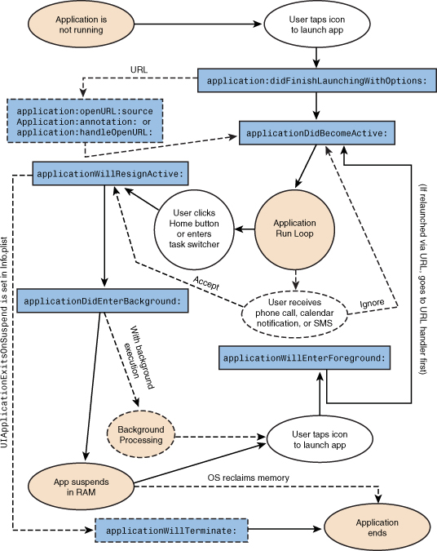

Slide 73
Methods of your application delegate called during state transitions:
application(_ application: UIApplication, didFinishLaunchingWithOptions launchOptions: [UIApplicationLaunchOptionsKey: Any]?) -> Bool:
    launchOptions: A dictionary indicating the reason the application was launched (if any). The contents of this dictionary may be empty in situations where the user launched the application directly.
    Called during the initial startup sequence followed by either the applicationDidBecomeActive: or applicationDidEnterBackground:
    application(_ application: UIApplication, didReceiveRemoteNotification userInfo: [AnyHashable : Any]) can be added in any class to listen to the same event (deprecated iOS10)
applicationDidBecomeActive(_ application: UIApplication)
applicationWillResignActive(_ application: UIApplication)
    Called when the user presses the Home button or the system launches another application
applicationWillEnterForeground(_ application: UIApplication)
  The application is about to enter the foreground.
  UIApplicationWillEnterForegroundNotification notification is also available for tracking when your application reenters the foreground.
applicationWillTerminate(_ application: UIApplication)
  The application is about to be terminated and purged from memory entirely.
  Use this method to perform any final clean-up tasks, such as freeing shared resources, saving user data, invalidating timers, and storing enough application state to reconstitute the application’s interface when it is relaunched.
applicationDidEnterBackground(_ application: UIApplication)

Slide 74
Moving to the Background
At least two things should be always done in the applicationDidEnterBackground: method:
Prepare your application to have its picture taken.
  When the applicationDidEnterBackground: method returns, the system takes a picture of the application’s user interface and uses the resulting image for transition animations. If any views in the interface contain sensitive information, you should hide or modify those views before the applicationDidEnterBackground: method returns.
Save user data and application state information.
  All unsaved changes should be written to disk when entering the background.
  The application might be quietly terminated while in the background for any number of reasons.
  This operation can be performed from a background thread as needed.
applicationDidEnterBackground: method has approximately five seconds to finish any tasks and return.
  If the method does not return before time runs out, the application is terminated and purged from memory.
  If more time is needed to perform tasks, call the beginBackgroundTaskWithExpirationHandler: method to request background execution time and then start any long-running tasks in a secondary thread.
  Regardless of whether you start any background tasks, the applicationDidEnterBackground: method must still exit within five seconds.

Slide 75
Application Termination
Applications are generally moved to the background and suspended
if any of the following conditions are true, the application is terminated and purged from memory instead of being moved to the background:
  The application is linked against a version of iOS earlier than 4.0.
  The application is deployed on a device running a version of iOS earlier than 4.0.
  The current device does not support multitasking;
  The application includes the UIApplicationExitsOnSuspend key in its Info.plist file

Slide 76
Preserving the Application’s State
At a minimum, save:
  The currently visible view controller
  The structural arrangement of the view controllers
  Information about each view controller, including:
    The class name of the view controller, which is used to recreate the view controller during the next launch cycle
    References to the data being managed by the view controller
One approach is to build a property list that is structured to match the organization of the view controllers.
The property list saves information about each view controller in a dictionary object. The keys of the dictionary identify properties of the view controller
Should save information only about those view controllers that are not part of your application’s default user interface.
Save in applicationDidEnterBackground: or applicationWillTerminate: as an application preference. In application:didFinishLaunchingWithOptions: method, load the property list from preferences

Slide 77
NSTimer/Timer
Scheduled invocation of a method in the main queue
let timer = Timer scheduledTimer (timeInterval:(NSTimeInterval)seconds
target:self
selector:#selector(doSomething:)
userInfo: AnyObject
repeats:(BOOL)trueOrfalse)
It runs around the run loop. The time may not be exact.
Avoid lengthy tasks in the main thread
Use background thread for time consuming tasks. ( Need to create an NSRunLoop , otherwise the timer will not fire.)
Timer.invalidate() method to stop the timer.

